Slide 1
IBM University Engagement Project Submission
“Exploring the Power of Agentic AI with IBM Granite and IBM Bob”

Slide 2

Faculty Name | Recent Passport Photo | Email ID | Mobile number [WhatsApp]
Dr.K.SHASHIKANTH |  | drkshashikanth@gmail.com | 9848224465
AI-Powered AI-Powered NeoCare Agent
Recommended font style and size:
Font Style: Arial
Font Size (Heading): 28
Font Size (Content): 20

Slide 3
Problem Statement -
Problem Statement : NeoCare
The Challenge
Newborns require continuous monitoring and specialized care during the first 28 days of life, yet many parents lack the knowledge and tools to monitor feeding, sleep, temperature, growth, and warning signs of illness. Delayed identification of health issues and inadequate access to healthcare guidance contribute to preventable neonatal complications. There is a need for an affordable, user-friendly solution that assists caregivers in monitoring newborn health, provides timely alerts, and connects them with healthcare resources.
The Objective
Build an AI-powered AI-Powered NeoCare Agent that delivers personalized newborn care guidance and health insights for parents, caregivers, and healthcare professionals. The solution should:
Monitor and analyze newborn health data such as feeding, sleep, body temperature, diaper changes, and growth.
Provide personalized recommendations based on the newborn's age, weight, and health status.
Detect potential health concerns early and generate timely alerts for caregivers.
Track vaccination schedules, medications, and routine health check-ups with automated reminders.
Offer evidence-based guidance on breastfeeding, nutrition, hygiene, safe sleep, and newborn care practices.
Maintain secure digital health records for continuous monitoring and easy sharing with healthcare professionals.
Support parents with 24/7 AI-powered assistance by answering common newborn care questions and providing actionable recommendations.
Improve neonatal health outcomes through early intervention, continuous monitoring, and informed decision-making.
Specific Objectives
Monitor essential newborn health parameters such as body temperature, heart rate, oxygen saturation (SpO₂), and sleep patterns in real time.
Provide instant alerts to parents and healthcare providers when abnormal health conditions are detected.
Track feeding schedules, diaper changes, sleep duration, and growth milestones to support healthy development.
Send reminders for vaccinations, medications, and regular health check-ups.
Offer educational guidance on newborn care, breastfeeding, hygiene, and recognizing danger signs.
Store and maintain health records for easy access and monitoring by caregivers and medical professionals.
Improve early detection of neonatal health complications, reducing the risk of severe illness and hospitalization.
Develop an affordable, reliable, and easy-to-use solution suitable for both hospitals and home environments.Tech Stack (Mandatory)
IBM Langflow / IBM Orchestrate+IBM Models

Slide 4
Proposed Solution -AI-Powered AI-Powered NeoCare Agent
The proposed solution is an AI-powered AI-Powered NeoCare Agent built using IBM BOB, IBM watsonx.ai, and Granite Models to provide intelligent, real-time healthcare assistance and support. The system addresses challenges in healthcare information access, symptom guidance, patient engagement, and preventive care through a modular multi-agent architecture.
At its core, the solution leverages a Retrieval-Augmented Generation (RAG) pipeline to retrieve accurate medical and healthcare information from trusted sources such as WHO guidelines, clinical knowledge bases, and organizational healthcare repositories. This information is embedded and stored in a vector database, enabling the system to retrieve, summarize, and deliver context-aware responses using Granite models.
The system consists of four key agents:
Healthcare Knowledge Agent retrieves and summarizes healthcare information, policies, and medical guidance using RAG.
Symptom Assistance Agent analyzes user-reported symptoms and provides preliminary guidance, self-care recommendations, and appropriate next steps.
Care Recommendation Agent generates personalized healthcare suggestions based on user profiles, medical history, lifestyle factors, and wellness goals.
Patient Support & Follow-up Agent enables users to track health-related activities, ask follow-up questions, receive reminders, and obtain continuous care guidance.
The solution includes a user-friendly dashboard (built with Streamlit or React) that provides healthcare insights, symptom tracking, wellness recommendations, and personalized health summaries through interactive visualizations.
IBM BOB is used to orchestrate agent workflows, while IBM watsonx.ai provides scalable model deployment, embeddings, governance, and monitoring capabilities. Granite models power reasoning, summarization, question answering, and personalized healthcare interactions.
Overall, this solution delivers an end-to-end intelligent healthcare assistant that enhances patient engagement, improves access to reliable healthcare information, supports preventive care initiatives, and enables personalized health management through AI-driven insights and recommendations.

Slide 5
Technology Used
IBM Bob platform -For designing and orchestrating multi-agent workflows visually
IBM Grainte model - for eg – ibm-granite-3-2-8b – For natural language understanding, reasoning, and personalization
IBM Cloud – It provides the infrastructure to build, deploy, and scale the Nutrition Agent efficiently. IBM Cloud enables a reliable, secure, and scalable environment for deploying the Nutrition Agent.
RAG– RAG to fetch real data first, then generate intelligent answers, making the AI-Powered NeoCare Agent more trustworthy and effective.
IBM Watsonx.ai - For model deployment, embeddings, and AI governance

Slide 6
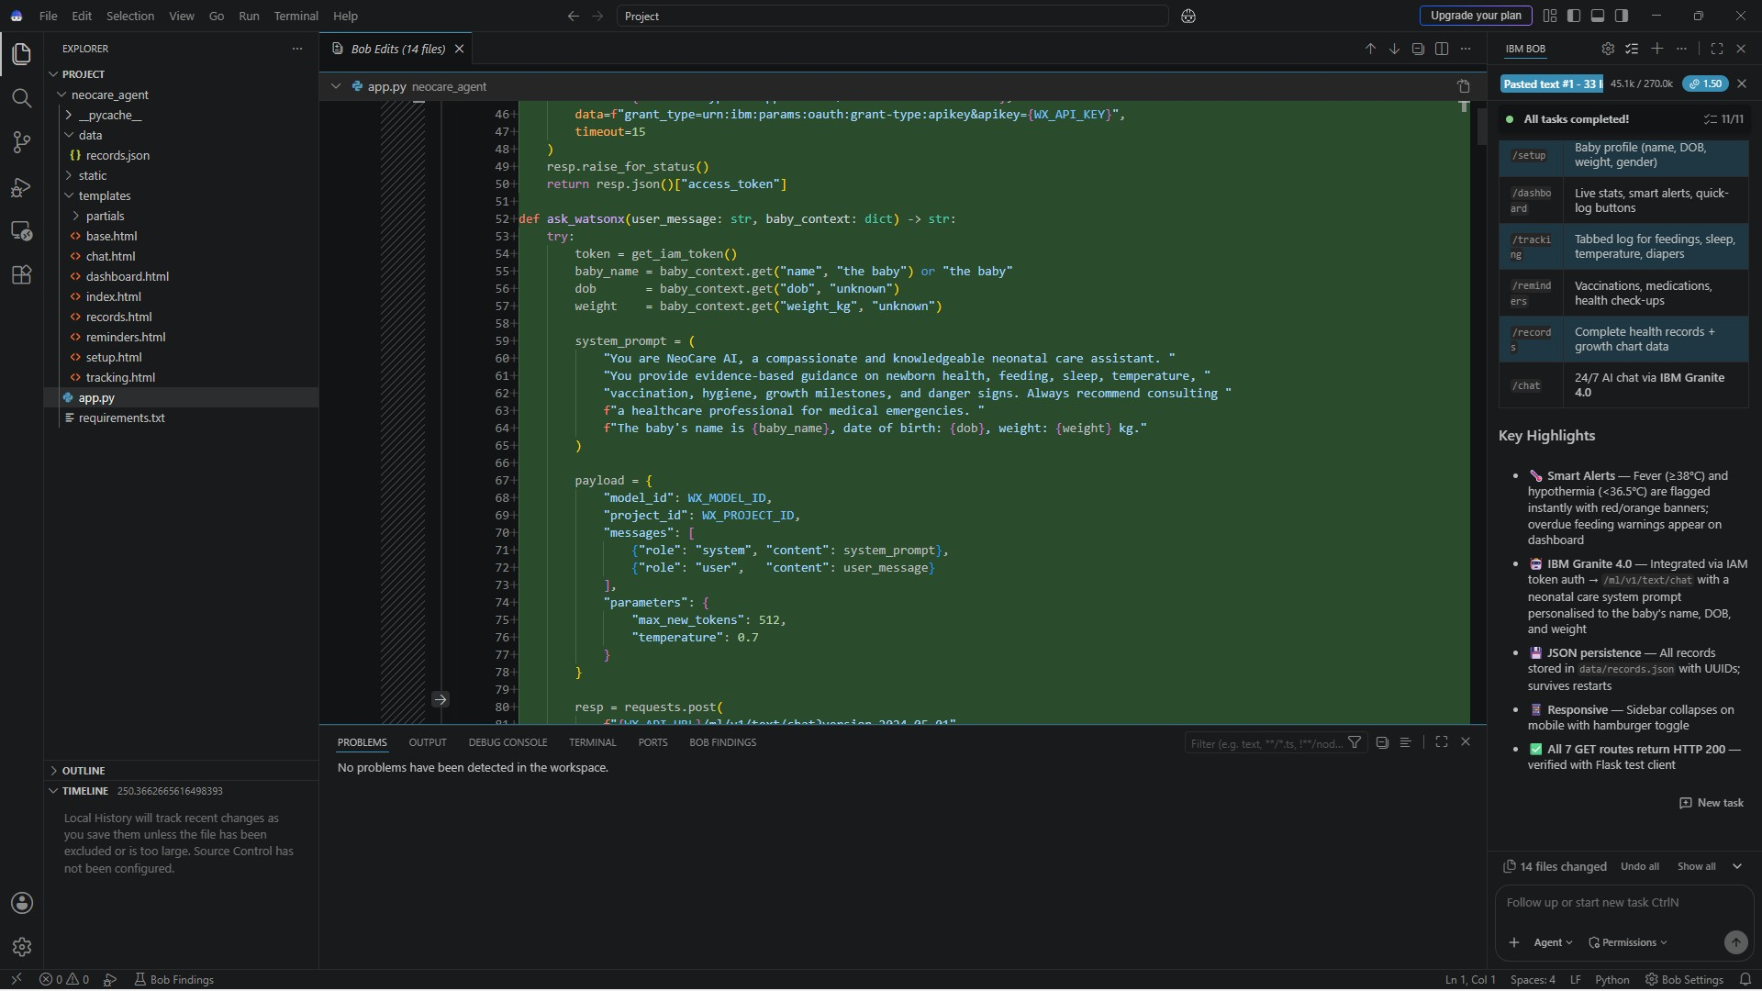
Required Files created using IBM bob -
_pysache_
data
static
Requirements.txt
App.py
Index.html

Slide 7
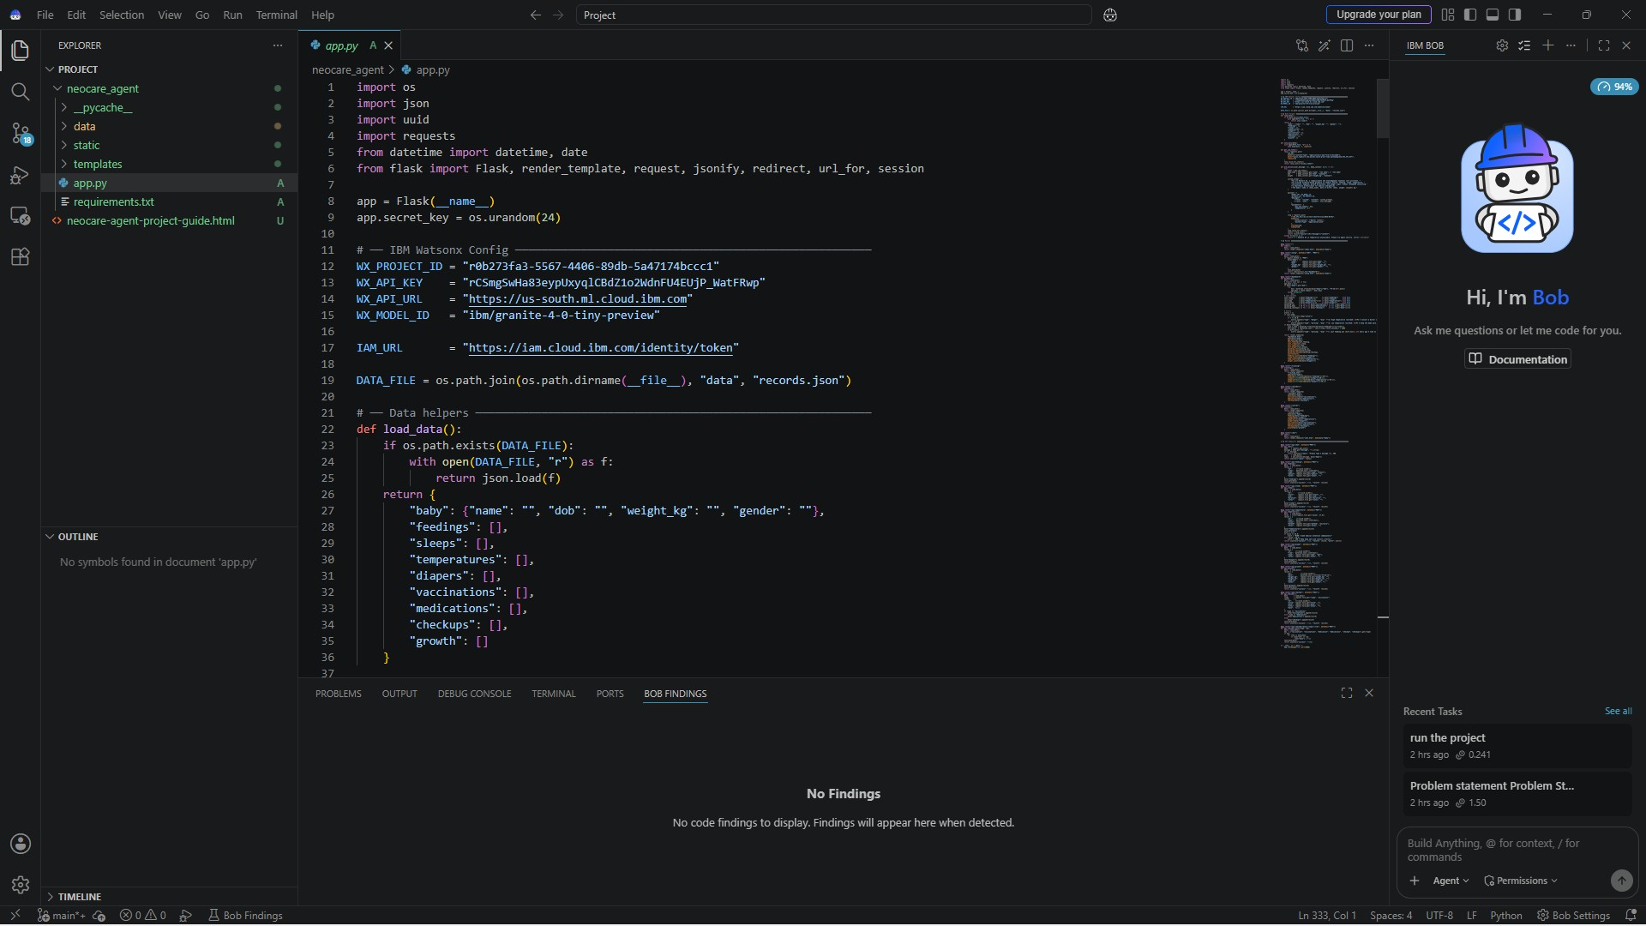
IBM Bob Screenshots:

Slide 8
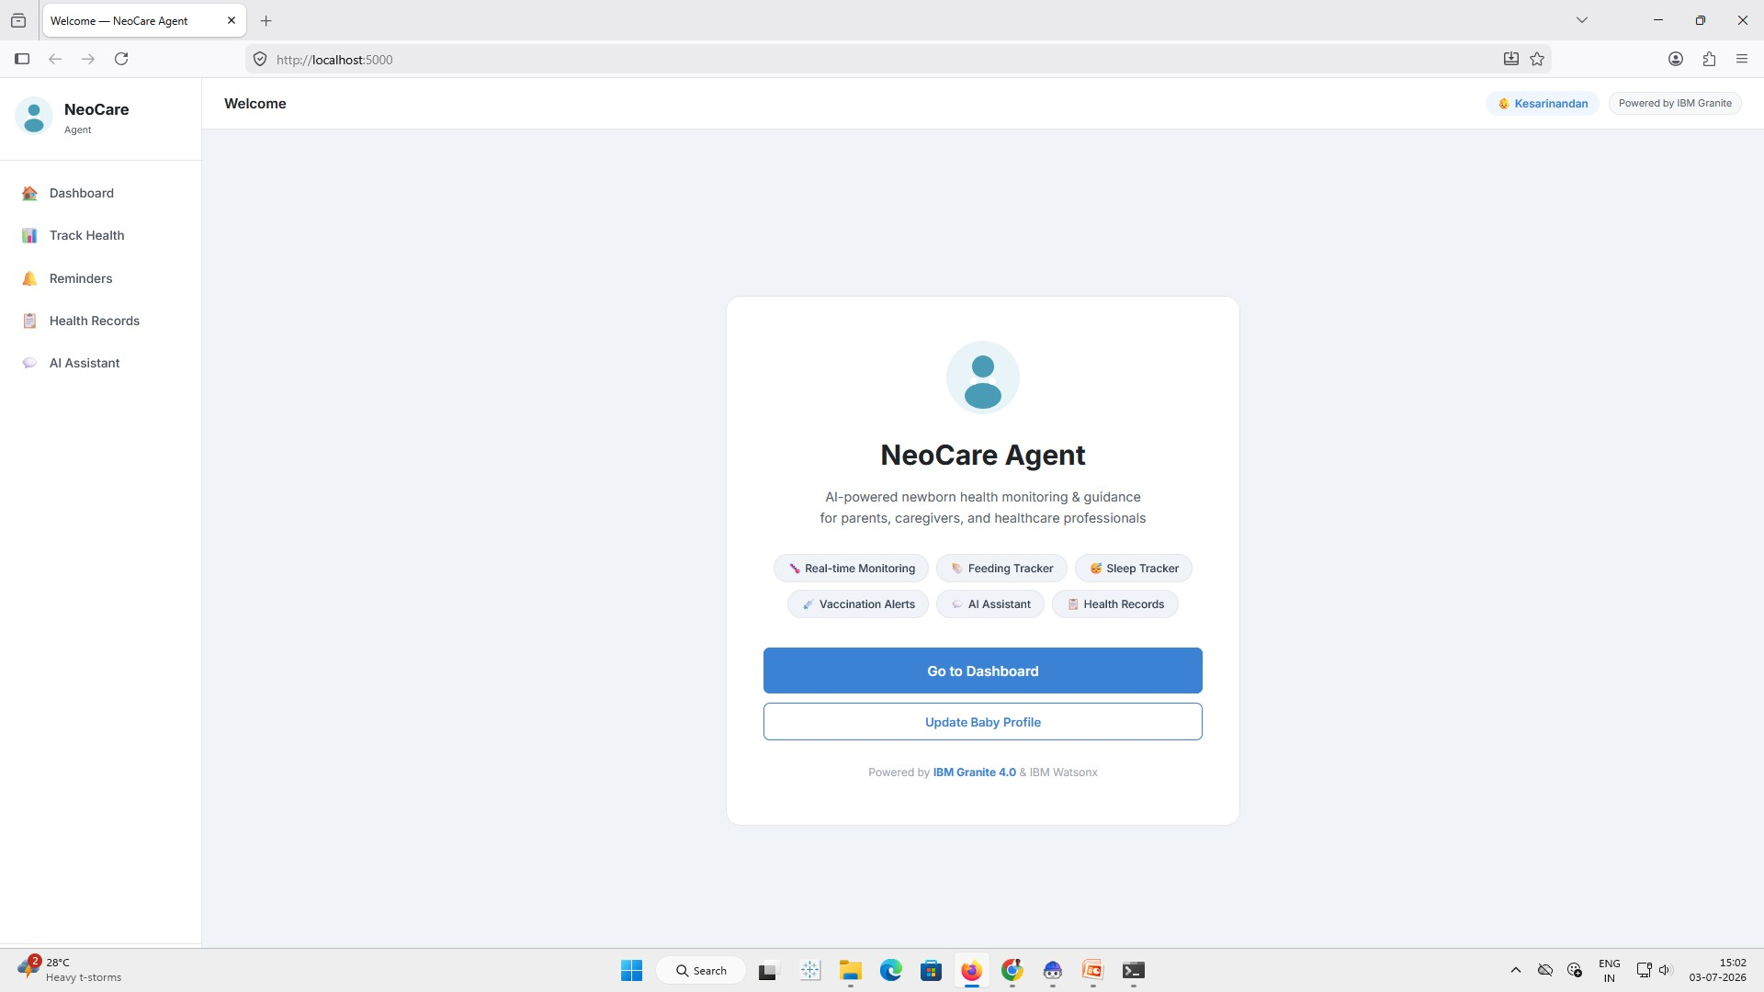
USER INTERFACE FOR AI-Powered NeoCare Agent

Slide 9
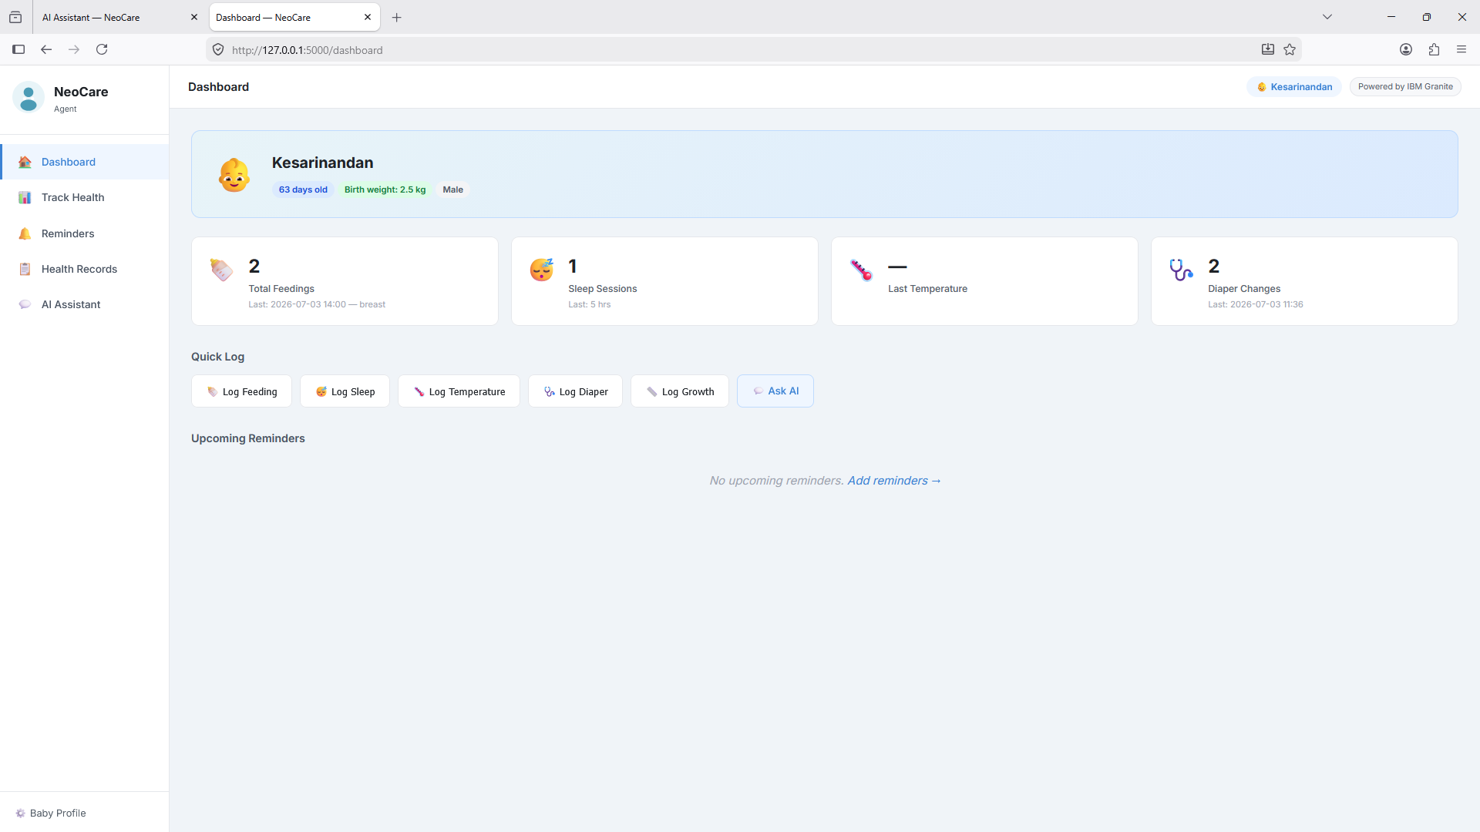
DASHBOARD FOR AI-Powered NeoCare Agent

Slide 10
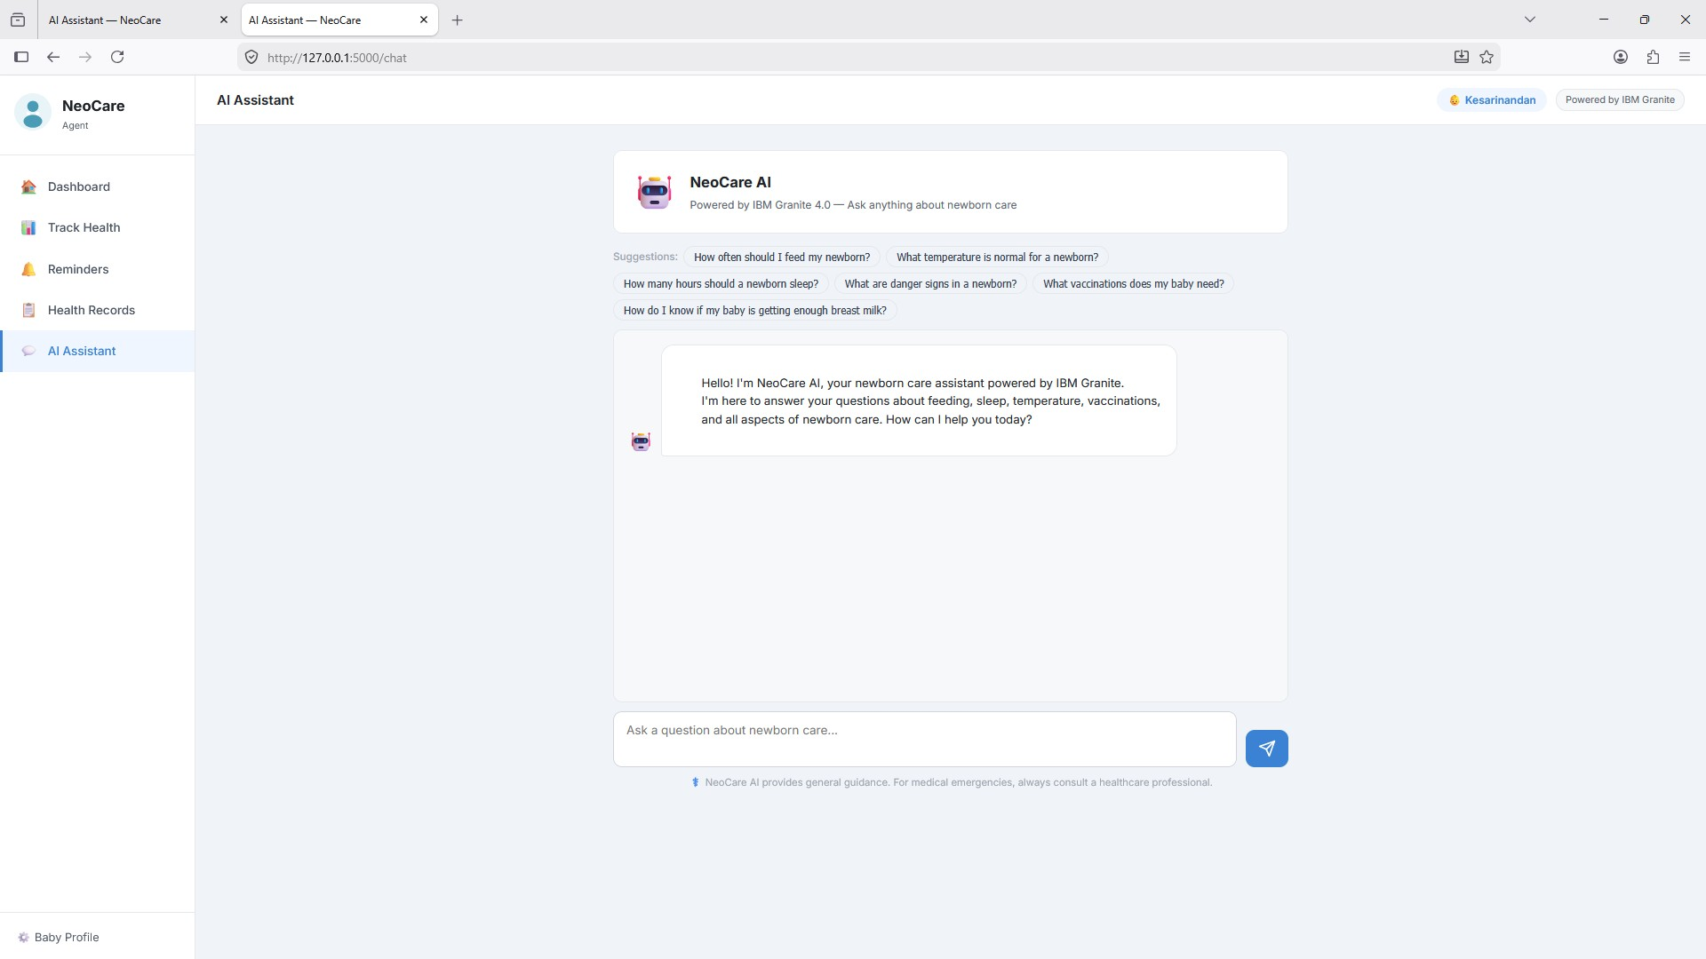
USER PROMPT AI-Powered NeoCare Agent

Slide 11
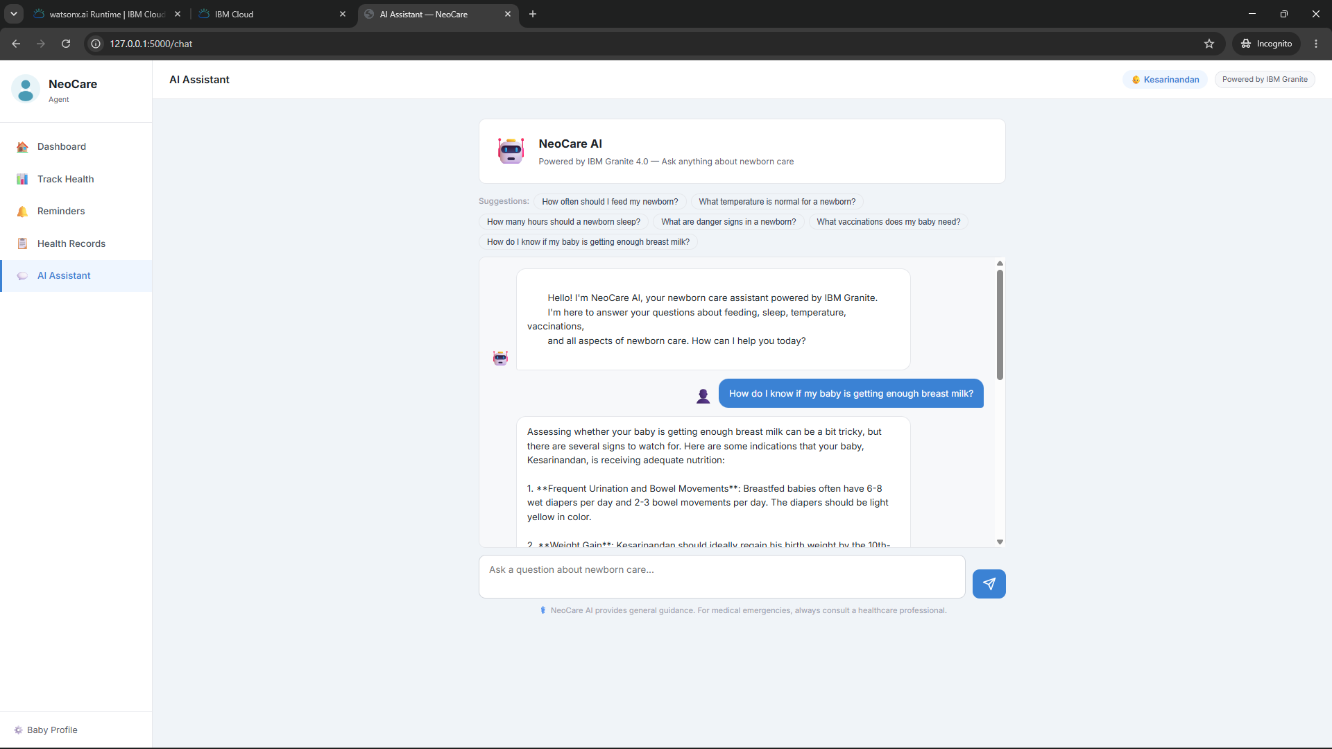
AI-Powered NeoCare Agent OUTPUT SCREEN

Slide 12
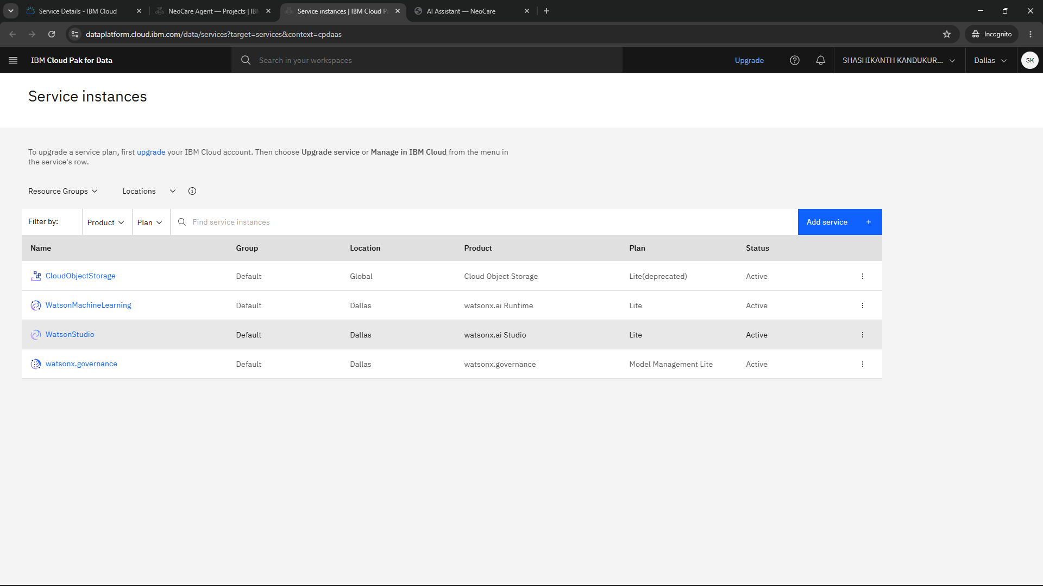
Services Instances IBM Cloud:

Slide 13
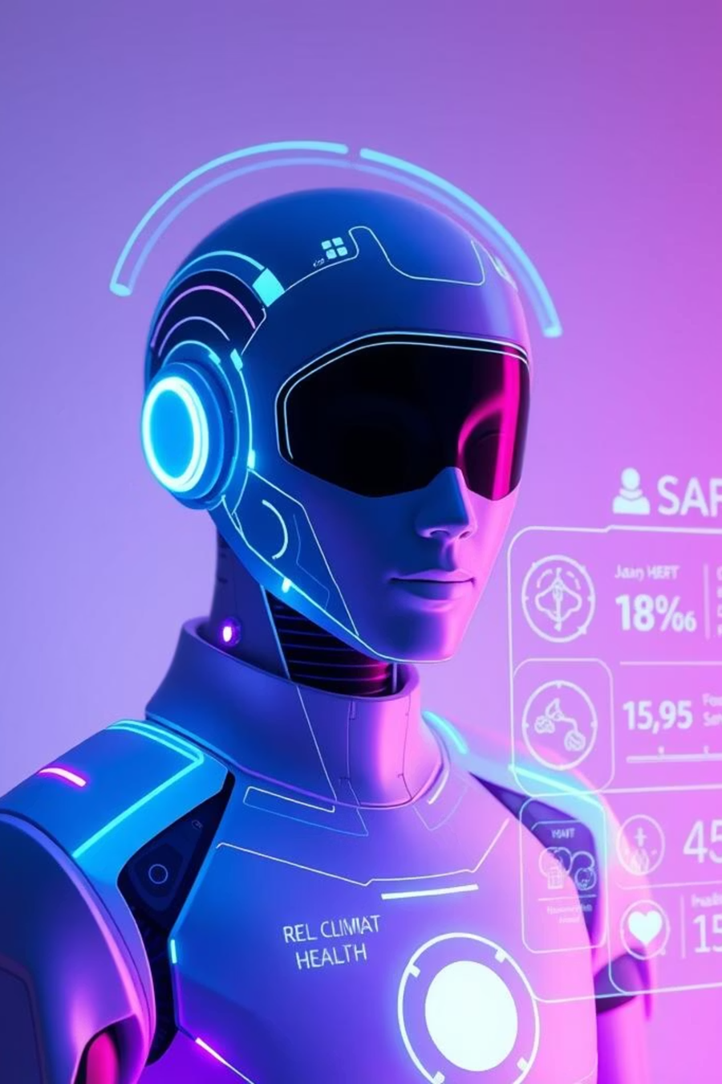
Role of Agentic AI in the solution
Agentic AI powers the AI-Powered NeoCare Agent as an intelligent and proactive newborn care assistant designed to support parents and caregivers in monitoring infant health and well-being. By continuously tracking essential health metrics such as feeding schedules, sleep patterns, body temperature, diaper changes, growth records, vaccinations, and medical appointments, the agent provides personalized recommendations based on the baby's profile and historical data. Its contextual reasoning capabilities enable it to detect potential health concerns, generate timely reminders, and deliver evidence-based guidance through natural language conversations. AI-Powered NeoCare Agent helps reduce caregiver workload by automating routine monitoring tasks while promoting preventive healthcare through early alerts and actionable insights. As a trusted digital companion, it enhances decision-making, improves newborn care management, and encourages timely consultation with healthcare professionals when necessary. In summary, AI-Powered NeoCare Agent leverages Agentic AI to provide intelligent, personalized, and proactive support, helping ensure better health outcomes and peace of mind for families caring for newborns.

Slide 14

Project Output Screenshot
Please put IBM Bob output screenshots with 2-3 prompts.
You can take 2-3 more slides for each screenshot
·
·
·

Slide 15
Project Output Screenshot
Please put IBM Bob output screenshots with 2-3 prompts.
You can take 2-3 more slides for each screenshot
·
·
·

Slide 16
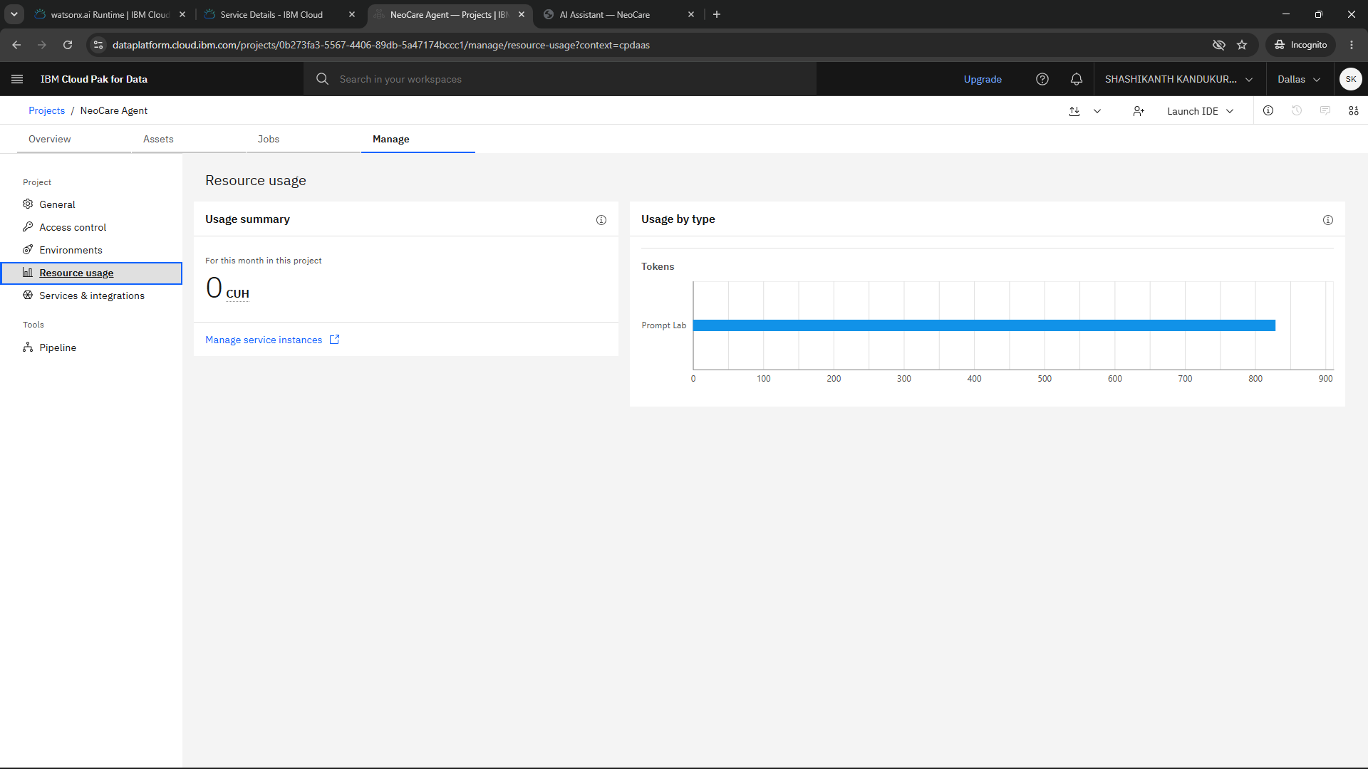
Resource Consumption
Please put IBM Bob output screenshots with 2-3 prompts.
You can take 2-3 more slides for each screenshot
·
·
·

Slide 17
Novelty and Uniqueness
AI-Powered NeoCare Agent is an AI-powered healthcare assistant designed specifically for neonatal care and newborn health management.
•It uses real-time patient data to predict potential health risks before critical symptoms appear, enabling early intervention.
•The system integrates vital signs, medical records, laboratory reports, and clinical notes for comprehensive analysis.
•It provides personalized care recommendations tailored to each newborn’s unique medical condition and needs.
•Explainable AI features allow clinicians to understand the reasoning behind recommendations and alerts.• AI-Powered NeoCare Agent continuously monitors patients and proactively notifies healthcare providers of potential complications.
•It integrates with IoT-enabled neonatal devices for automated and accurate data collection.
•The platform enhances medication safety through dosage verification and interaction checks.
•Automated documentation and reporting help reduce administrative workload for healthcare professionals.
•Its combination of predictive analytics, personalized decision support, and seamless clinical integration makes it unique among healthcare AI solutions.

Slide 18
Git Hub Link
Github URL –https://github.com/shashi1215/IBM-AGENTIC-AI-CYBER-SECURITY-AND-QUANTUM-COMPUTING
Make sure you have Uploaded following three files into your github repository
1) All Agent relevant files of IBM Cloud ,
2) Problem statement.pdf file
3) Project presntation.pptx file
4)any other files
·
·
·

Slide 19
Future Scope
1.Integration with Wearables & Health Devices –
The future scope of AI-Powered NeoCare Agent lies in expanding its predictive capabilities through advanced artificial intelligence and machine learning models. By incorporating larger neonatal datasets and real-time analytics, the system can improve the accuracy of early disease detection, risk assessment, and personalized treatment recommendations. Integration with emerging technologies such as wearable health sensors, smart incubators, and Internet of Things (IoT) devices will enable continuous monitoring and faster clinical decision-making, ultimately improving neonatal outcomes and reducing mortality rates.
2.AI-Powered Voice Assistant & Multilingual Support –
In the long term, AI-Powered NeoCare Agent can evolve into a comprehensive neonatal healthcare ecosystem that supports remote monitoring, telemedicine, and cross-hospital data sharing. The platform can be enhanced with multilingual communication, advanced medical image analysis, and interoperability with hospital information systems and electronic health records. These developments will make quality neonatal care more accessible, especially in resource-limited and rural areas, while assisting healthcare professionals with efficient, evidence-based, and data-driven patient management.
·
·

Slide 20
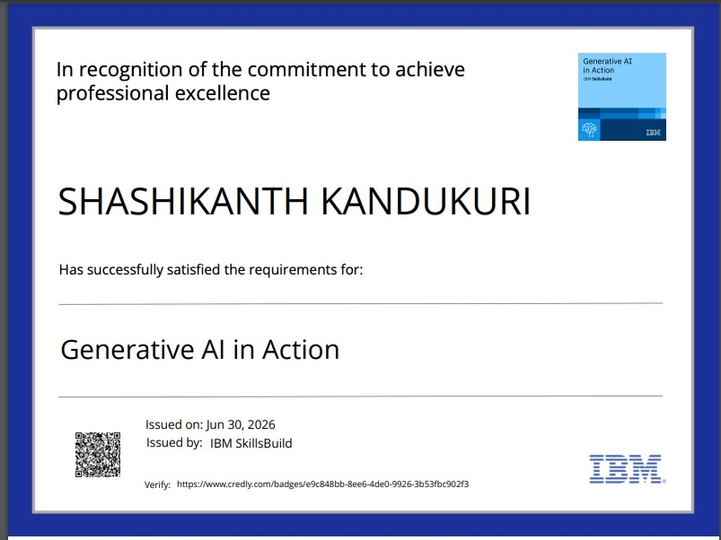
Certificates Earned:

Slide 21
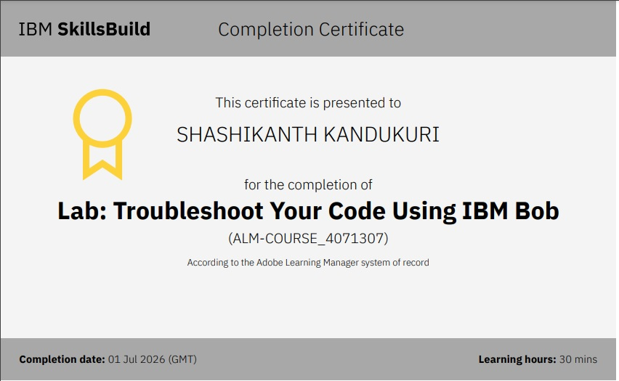
Certificates Earned:​
Add your IBM BOB Certificate

Slide 22
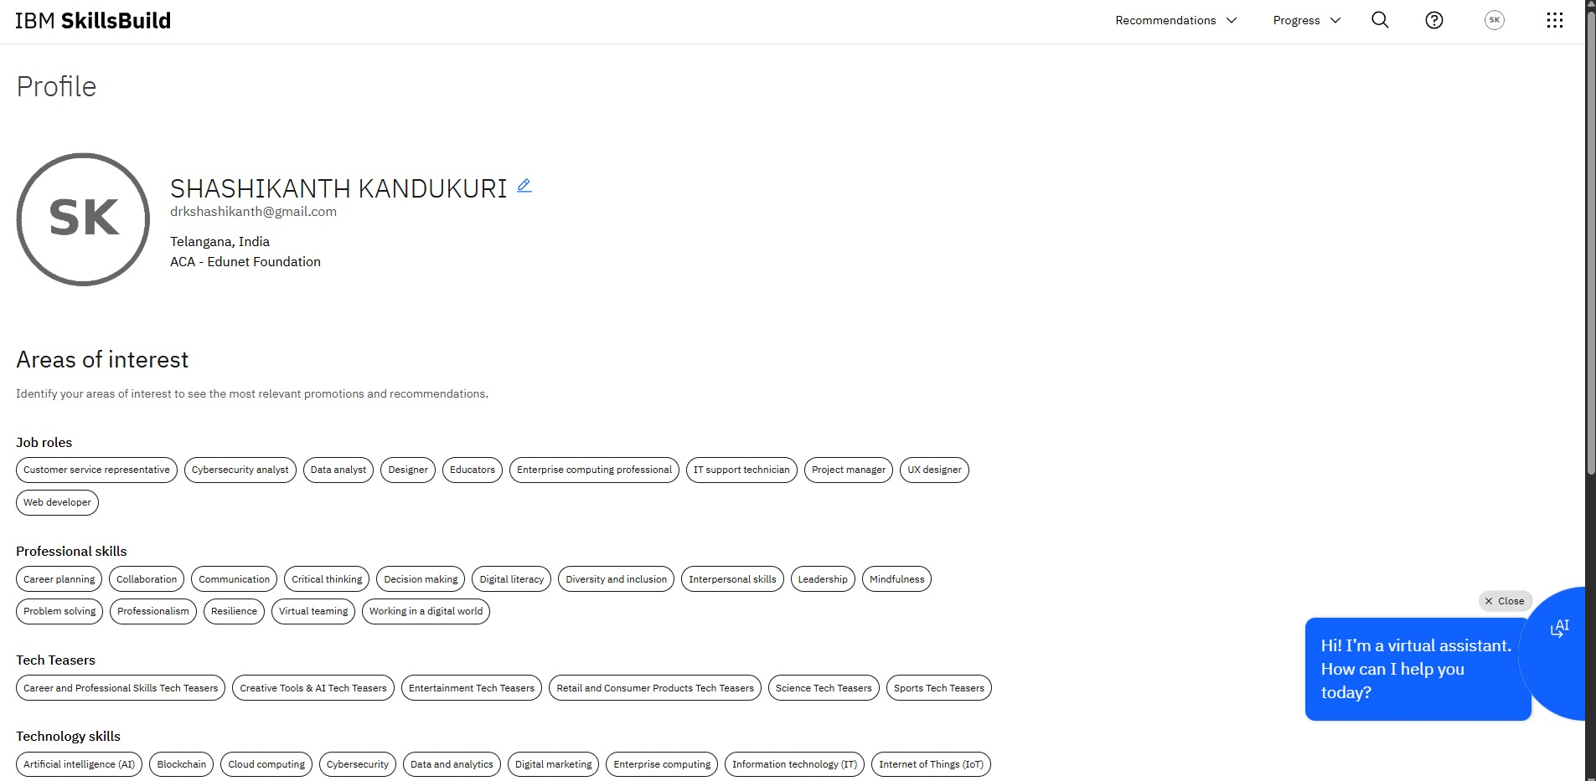
IBM SKILLSBUILD PROFILE

Slide 23


